Slide 1
Mini-project
​

Slide 2
GROUP MEMBERS
Mohd. Talha Nadeem , 2060004
Puru Mittal , 2061898
Mukund Maheshwari , 2060005

Slide 3

E-COMMERCE website

Slide 4
INTRODUCTION
E-commerce is fast gaining ground as an accepted and used business paradigm. More and more business houses are implementing web sites providing functionality for performing commercial transactions over the web. It is reasonable to say that the process of shopping on the web is becoming commonplace.

Slide 5




OUR SYSTEM
Close the gap
Target audience
Cost savings
Easy to use
Our website makes consumer lives easier, and no other product on the market offers the same features​
Large variety of products available for all of the age groups
Reduce expenses , reasonable prices and guarantee of 100% good quality products. Easy return and replacement available.
Simple design that gives customers the targeted information they need​

Slide 6
SOFTWARE REQUIREMENTS
OPERATING SYSTEM
Win-98, Win-XP, Linux or any other higher version
SOFTWARE REQUIRED
Internet Explorer, Mozilla Firefox or any web browser

Slide 7
hardware REQUIREMENTS
PROCESSOR
Pentium II, Pentium III, Pentium IV or higher
RAM REQUIRED
1 GB or higher

Slide 8
LANGUAGES USED

Slide 9
HTML
HTML stands for Hyper Text Markup Language, it is the standard markup language for creating Web pages. It stands for Hyper Text Markup Language. It is the standard markup language for creating Web pages. It describes the structure of a Web page. It consists of a series of elements. It elements tell the browser how to display the content. It elements label pieces of content such as "this is a heading", "this is a paragraph", "this is a link", etc.

Slide 10
CSS
CSS (Cascading Style Sheets) is a stylesheet language used to design the webpage to make it attractive. The reason for using this is to simplify the process of making web pages presentable. It allows you to apply styles to web pages. More importantly, it enables you to do this independent of the HTML that makes up each web page.
Styling is the essential property for any website. It increases the standards and overall look of the website that makes it easier for the user to interact with it. A website can be made without CSS, as styling is MUST since no user would want to interact with a dull and shabby website.

Slide 11
JavaScript
JavaScript is the world most popular lightweight, interpreted compiled programming language. It is also known as scripting language for web pages. It is well-known for the development of web pages, many non-browser environments also use it. JavaScript can be used for Client-side developments as well as Server-side developments.

Slide 12
Graphical User interface

Slide 13
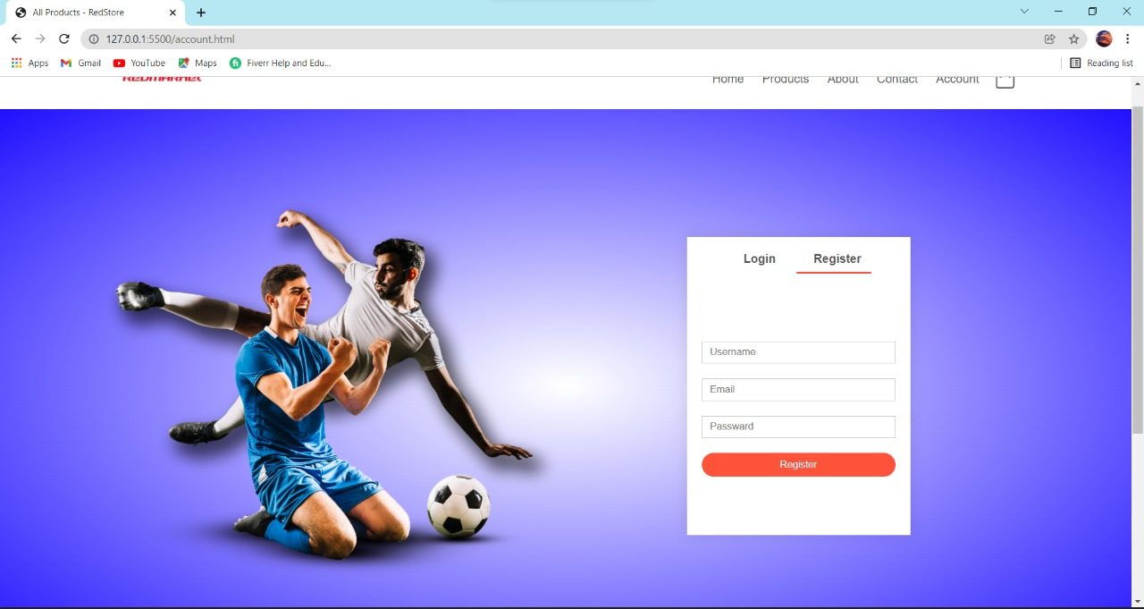

Slide 14
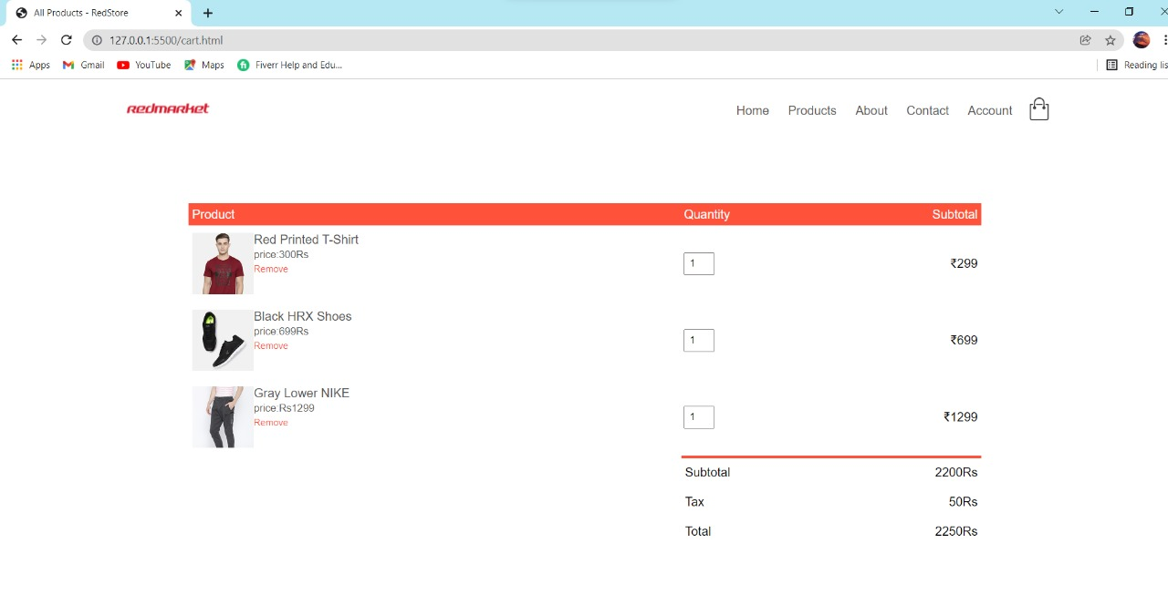

Slide 15
FEATURES
Catalogue Browsing
Product Browsing
Product Rating
Shopping Cart
Auto generated Bill

Slide 16
Limitations
There could be software/hardware compatibility issues, as some e-commerce software may be incompatible with some operating system or any other component.
There can be lack of system security, reliability or standards owing to poor implementation of e-commerce.
Not many functions can be performed
Backend not used

Slide 17
Thank you

